Slide 1


WebGIS Lab 2
DEBAYAN MANDAL

Slide 2

Lab Hours
Notes:
Please mail me before. Don’t wait till the submission date.

Slide 3
ArcGIS Online
Online, collaborative web GIS – Interactive web maps
Use, create, and share maps, scenes, apps, layers, analytics, and data.
Access to Living Atlas of the World, apps, and ESRI's secure cloud
Add items and publish web layers.
Overview: - ArcGIS Online | Web GIS Mapping Software for Everyone (esri.com)

Slide 4
ArcGIS Field Maps
Collecting and updating data in the field
Both Offline and Online
Works on Windows, Android, and iOS
Attach PDF, Excel and Word documents to assets or observations
Reuse list entries between forms
Capture additional metadata when collecting using GPS
Use app links to update existing feature attributes

Slide 5
ArcGIS Online Web Mapping
Learning Outcomes:
Add layers to a map
Add data stored to a map
Change map symbols
Configure pop-ups
Share the map as a web app.

Slide 6
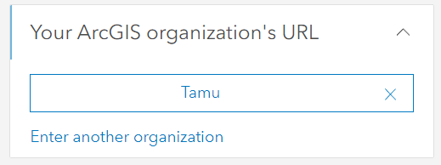
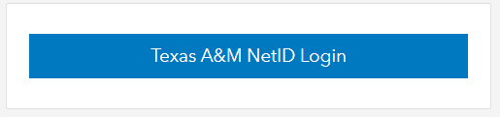
ArcGIS Online Web Mapping
Sign into your ArcGIS organizational account
.

Slide 7
ArcGIS Online Web Mapping
On the ribbon, click the Map tab.

Slide 8
ArcGIS Online Web Mapping
On the ribbon, click Open in new Map Viewer, to open a brand new map

Slide 9
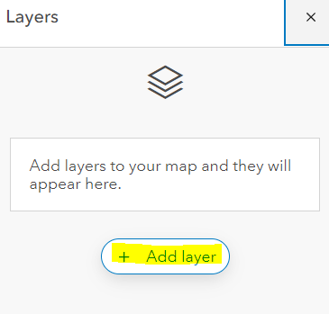
ArcGIS Online Web Mapping
In the Layers pane, click Add layer.

Slide 10
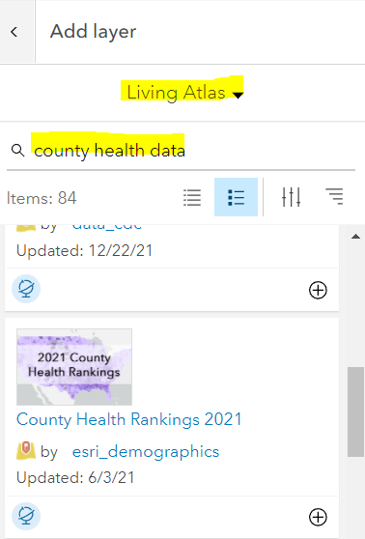
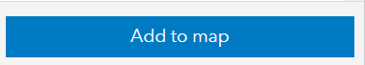
ArcGIS Online Web Mapping
Click My Content and choose Living Atlas
In the search box, type county health data and press Enter.
We are going to use County Health Rankings 2021 feature layer by esri_demographics (Source:2020 County Health Rankings Key Findings Report)
Select it to check for more details.
Add it to the map.

Slide 11
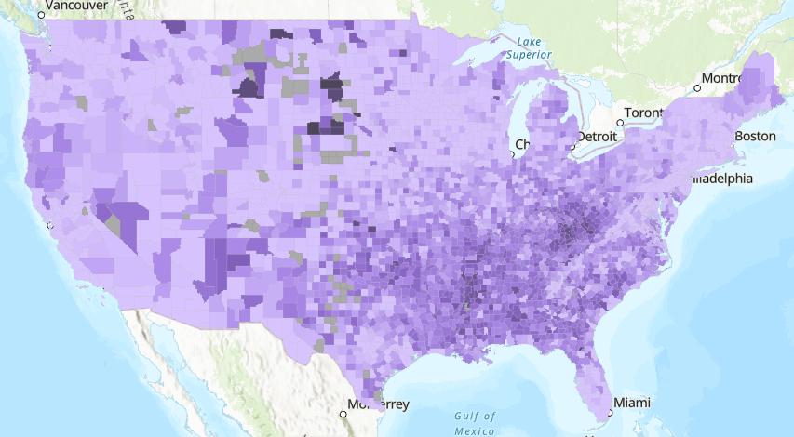
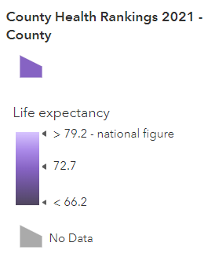
County Map now is displayed:

Slide 12
Explore data using dot density styling
Explore some of the attribute fields in the layer using dot density styling

Slide 13
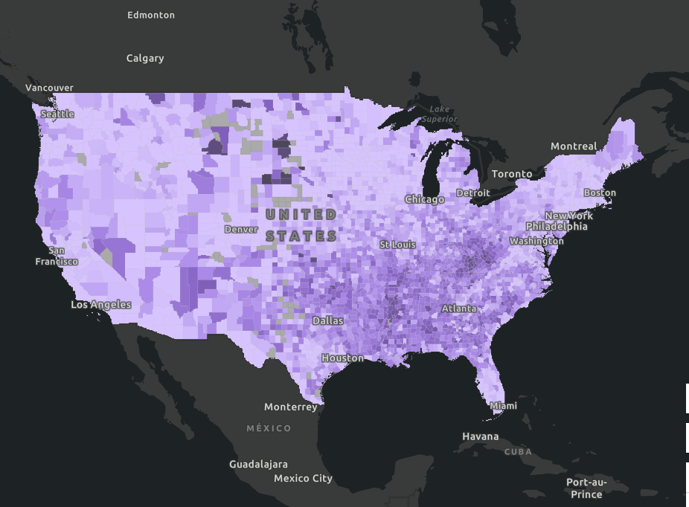
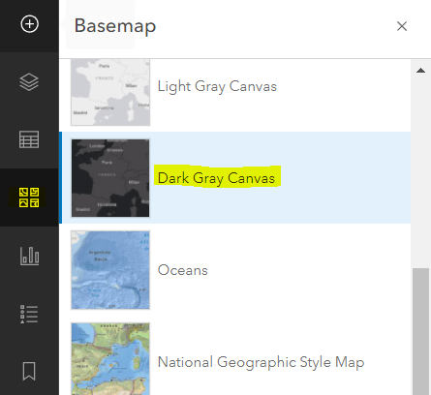
Let’s change the basemap to better emphasize our data
Click the basemap icon again to close the pop up.

Slide 14
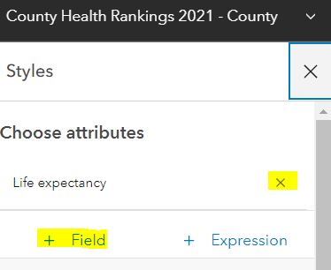
ArcGIS Online Web Mapping
To change the styles of the map, we go to the Styles icon on the right-hand side.
Currently it is showing gradient based on Life Expectancy. So, we can cancel that.
Suppose we would like to view these gradients:
Count of Non-Hispanic Black population
Count of American Indian & Alaska Native population
Asian population
Count of Hispanic population
Non-Hispanic White population
Use + Field option to add in the new fields
Notes:
Remember to change layer to county health rankings 2021 from sketch

Slide 15
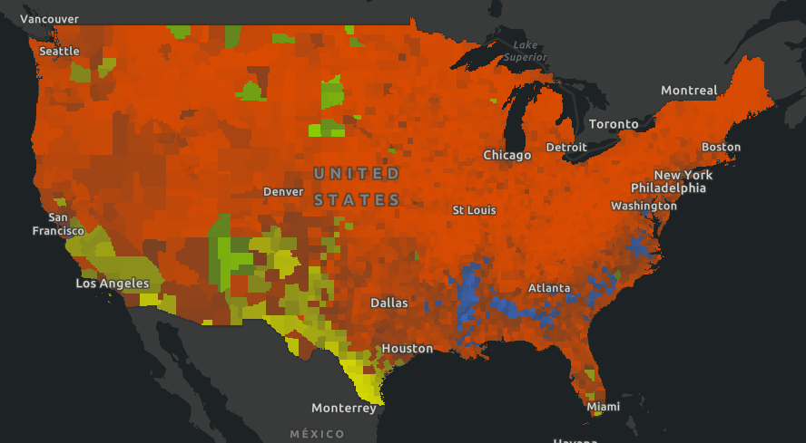
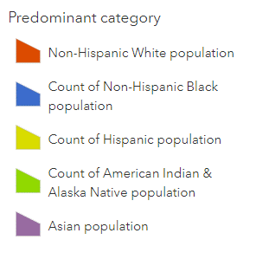
It overlaps the data. So, it’s not usable.

Slide 16
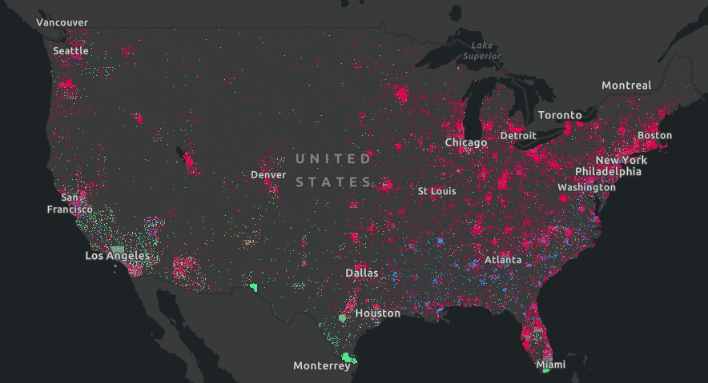
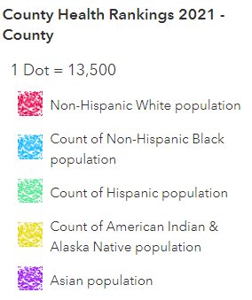
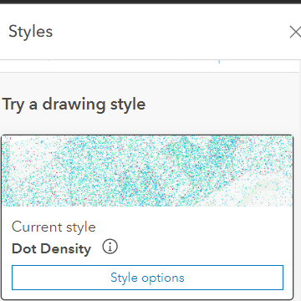
Changing drawing style to dot density allows us to view the data properly in this case.

Slide 17
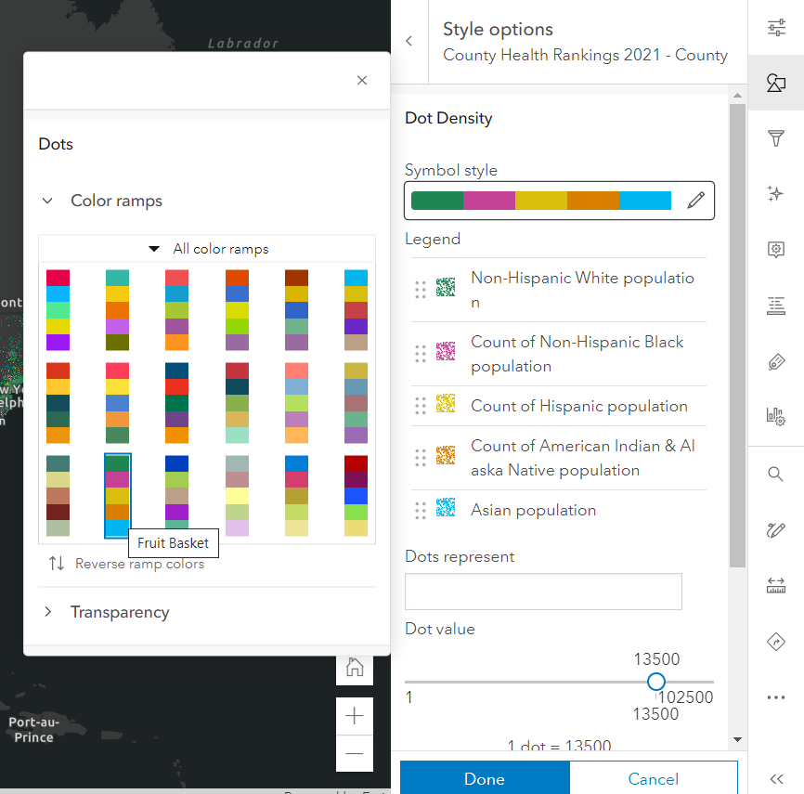
Changing Color ramp is possible through “Style Options” in the drawing style card. We are using fruit basket color ramp here. To see the name of a color ramp, hover.

Slide 18
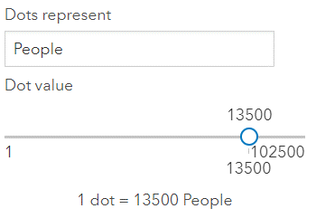
ArcGIS Online Web Mapping
Mention Dot represents people to show up on the symbology
The slider scales the dot value, change it around if wanted
It dynamically updates the data and so is very useful for visual purposes.

Slide 19
Interpreting the Data
Explore national patterns to better understand the adult obesity situation in the United States

Slide 20
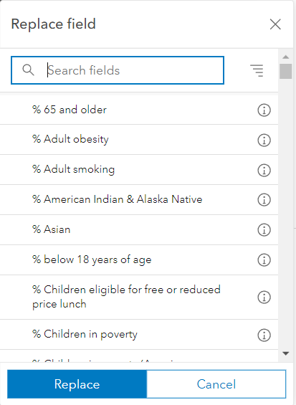
ArcGIS Online Web Mapping
Click County Health Rankings 2021 - County layer in the Layers tab
In Styles, remove everything except Non-Hispanic White population.
Click on the field and replace it with %Adult Obesity
Notes:
This can also be done through Add field. This is to make you familiar with Replacing a field in styles.

Slide 21
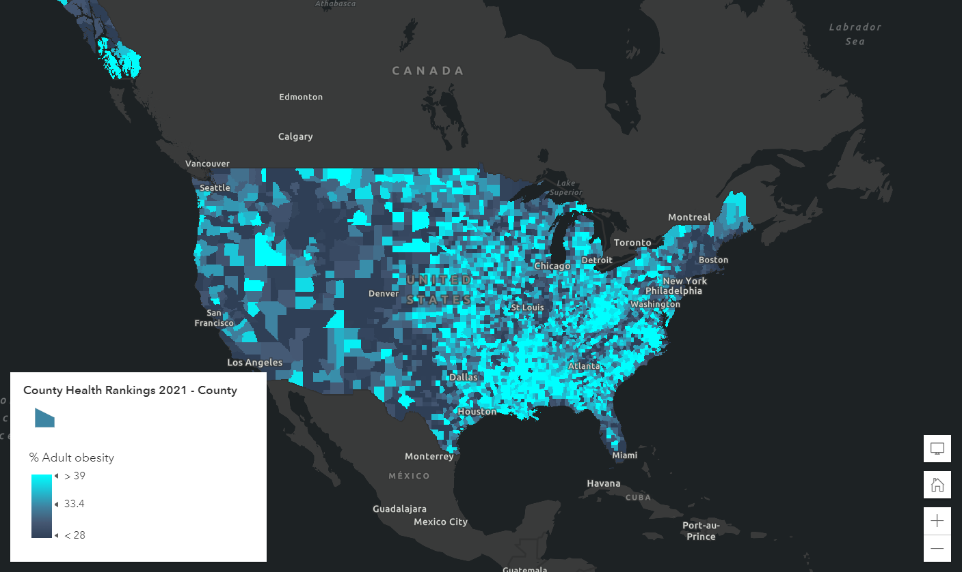
Notes:
The colors might be different in your case.

Slide 22
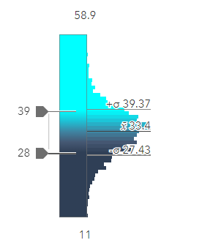
ArcGIS Online Web Mapping
Click Style Options in the Style tab to view the data distribution. The histogram allows us to understand the data.
Maximum – 58.9%
Minimum – 11%
Average – 33.4%
Notes:
This can also be done through Add field. This is to make you familiar with Replacing a field in styles.

Slide 23
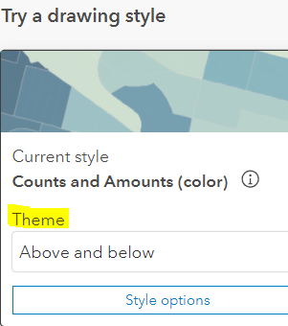
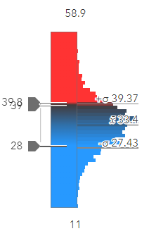
ArcGIS Online Web Mapping
Change theme to Above and Below
This theme will change coloring above and below the average value
To change the turning value, got to the histogram again and click on it. (Let’s try the value 39.8% which is the national average by CDC)
The average differs as CDC considers population differences in between counties.
Notes:
This can also be done through Add field. This is to make you familiar with Replacing a field in styles.

Slide 24
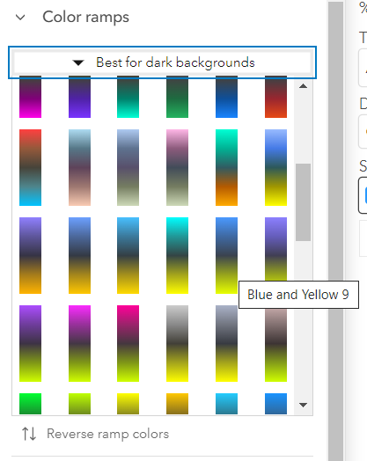
ArcGIS Online Web Mapping
Let’s choose a different color ramp to make the data stand out better against the dark basemap.
In the Style options, you would find the following: -
Symbol style – Color map – All color ramps – Best for dark backgrounds.
Let’s choose the ramp Blue and Yellow 9
Click Reverse ramp colors to invert the ramp
Notes:
This can also be done through Add field. This is to make you familiar with Replacing a field in styles.

Slide 25
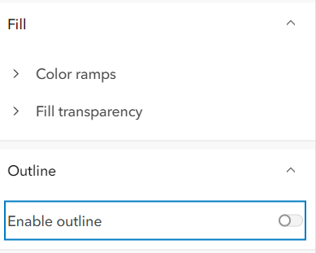
ArcGIS Online Web Mapping
Let’s remove county boundaries from being visible and see how that looks
Same place where we changed color ramp. Go into Outline and turn off Enable Outline.
Notes:
This can also be done through Add field. This is to make you familiar with Replacing a field in styles.

Slide 26
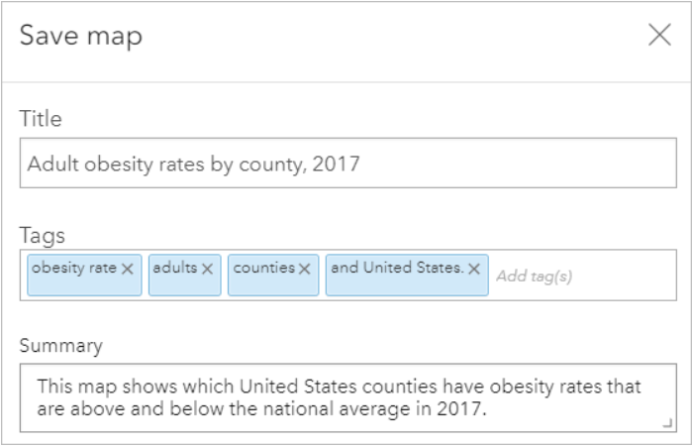
ArcGIS Online Web Mapping
To save it click the save and Open icon from the right-side toolbar (Content) and click Save.
Fill in the details as the image to the right and confirm (Save Map).
Notes:
Use Enter key to separate tags

Slide 27
Configure pop-ups
Customize the pop-up to highlight the adult obesity rates per county

Slide 28
ArcGIS Online Web Mapping
Click on a county to open its pop-up.
On left hand toolbar (Settings), select Configure Pop-ups.
Let’s remove the Text and Media that was preset. Use the three dots (options) next to them to delete.
Add content and click Text and type these: -
The adult obesity rate (body mass index of 30 or more) in
{name – Choose the County Name {name} as it pops up.
The curly braces signify Attribute fields so it can pull data from the clicked feature.

Slide 29
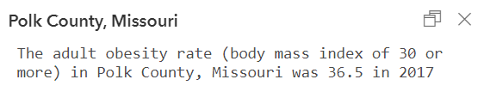
ArcGIS Online Web Mapping
add a comma and a space, and type {Stat. From the field list, choose State {STATE}
After {State}, add a comma and a space and type: was {Adult
From the list, choose % Adult obesity {v011_rawvalue}
At the end of the sentence, add: in 2017. Confirm.
The popup is now updated.

Slide 30
Filter data to inform policy intervention
Learning to use a filter to focus on an area

Slide 31
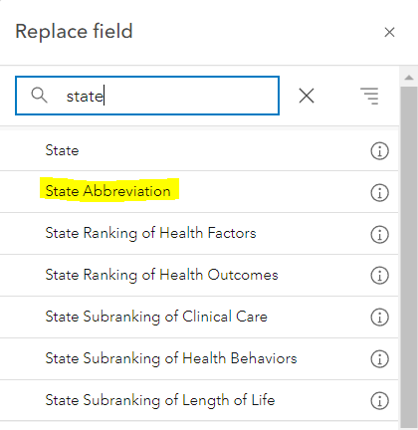
ArcGIS Online Web Mapping
Click on Filter icon from Settings toolbar.
In the Filter pane, click Add expression.
Click the first expression field box (FIPS). And Replace field.
In the Search fields box, type state. Click the State Abbreviation field and click Replace.

Slide 32
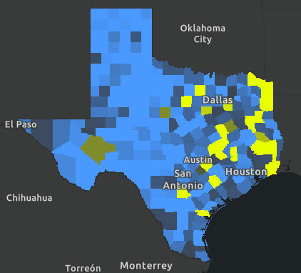
ArcGIS Online Web Mapping
In the Filter pane, click is and choose includes.
Select Values come up. Click it.
Choose TX and Save.
Now all except Texas will be greyed out.

Slide 33
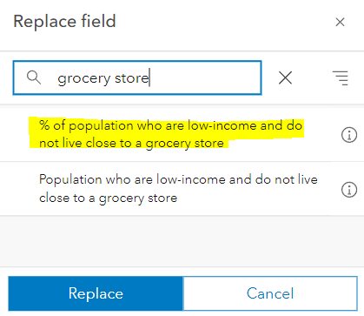
ArcGIS Online Web Mapping
Click on Filter icon from Settings toolbar again.
In the Filter pane, click Add expression.
Click the second expression field box (FIPS). And Replace field.
In the Search fields box, type grocery store. Click the % population who are low-income and do not live close to a grocery store field and click Replace.

Slide 34
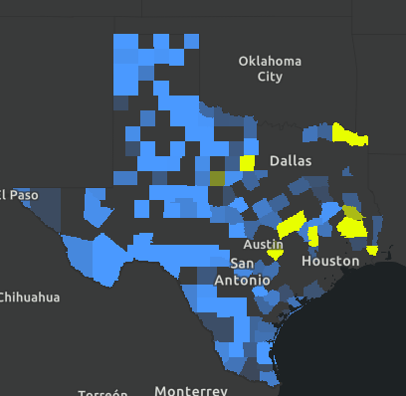
ArcGIS Online Web Mapping
Confirm that is at least is chosen.
The third box automatically displays a value of 8.65. This value is the average percentage calculated from the data.
In the Filter pane, click Save. Save the map.

Slide 35

ArcGIS Online Web Mapping
Click Share map on the Contents (dark) toolbar and choose Everyone (public)
Click Create app and click Instant Apps. Choose Basic for now.
Name it My first Web App - Your name and click Create App.
Look into the other options for later use. Every type will have Preview option.
You can also use Experience Builder, Story Maps or Dashboard to be able to customize it more to your liking.
Notes:
Use Enter key to separate tags

Slide 36
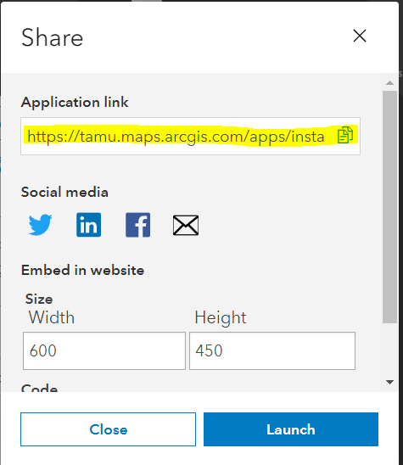
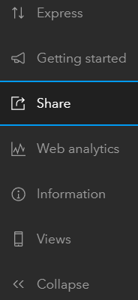
ArcGIS Online Web Mapping
Click Share and make sure it is shared with public. It can take you to a new window and you must click share again.
Copy the application link and Publish.
Eg: - (Submit this) https://tamu.maps.arcgis.com/apps/instant/basic/index.html?appid=84b260224d934d8da6972ae9dd117ffd
Notes:
Check if the link is working by opening it in an incognito window

Slide 37
Field Maps for ArcGIS
Learning Outcomes:
Preparing a layer
Making a map
Using the map in Field Maps

Slide 38
Prepare a layer
Part 1

Slide 39
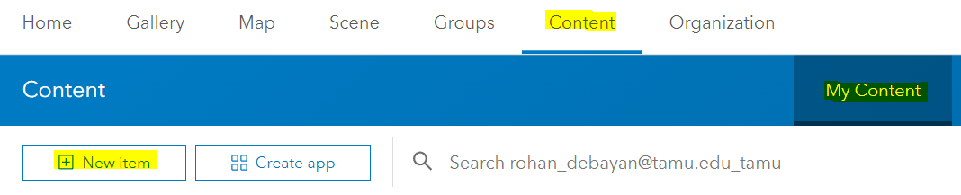
Field Maps for ArcGIS
Go to Content, and in My Content click New item and choose Feature Layer to open the Create a feature layer dialog.

Slide 40
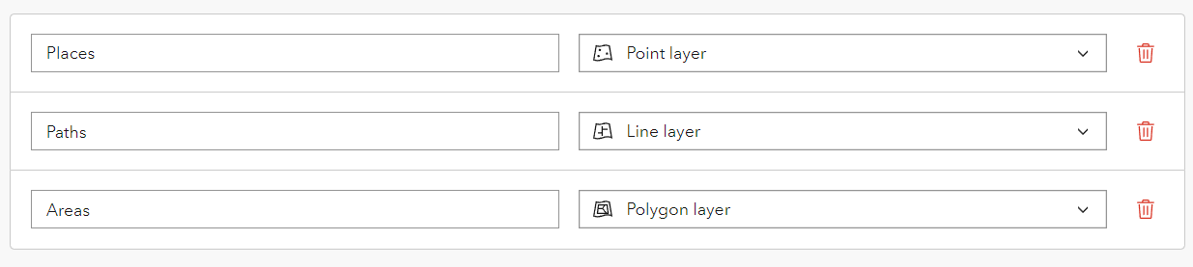
Field Maps for ArcGIS
Create a blank layer
Add a Point, Line and Polygon layer. Change the names according to the image below.

Slide 41
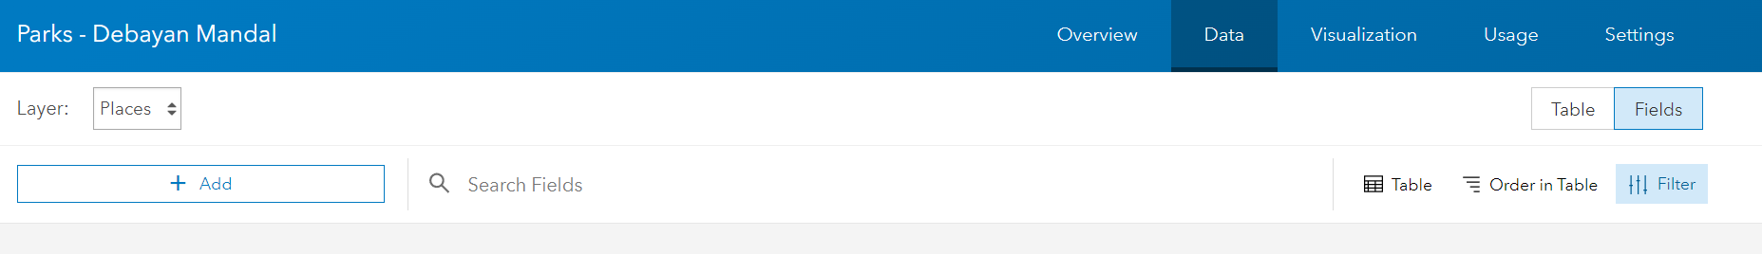
Field Maps for ArcGIS
Provide a title: - Parks – Your Name. Click Save.
We will create the fields that define the form for the Places layer.
Go to the Data tab of the item page and go to Fields.
Click +Add

Slide 42
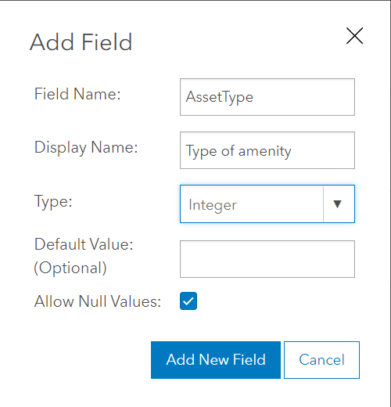
Field Maps for ArcGIS
Click Add. Give a name AssetType and an alias Type of amenity. Choose type Integer – you’ll create a list of choices later. Accept the other defaults and click Add New Field.

Slide 43
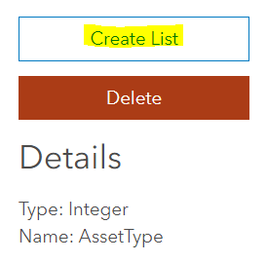
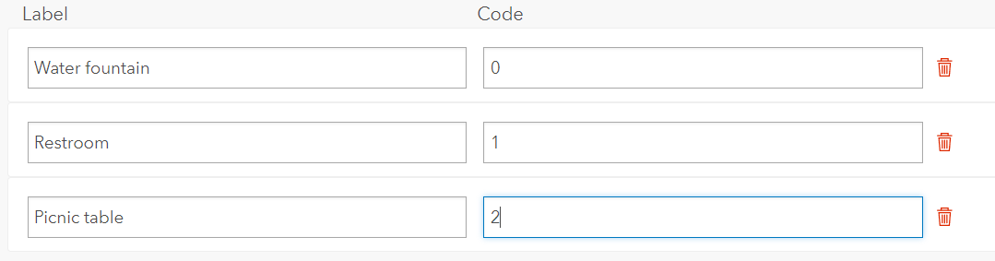
Field Maps for ArcGIS
Click Type of amenity in the Display Name list and click Create List to create a list of choices for the type of amenity.
Enter Labels as below and click Save.

Slide 44
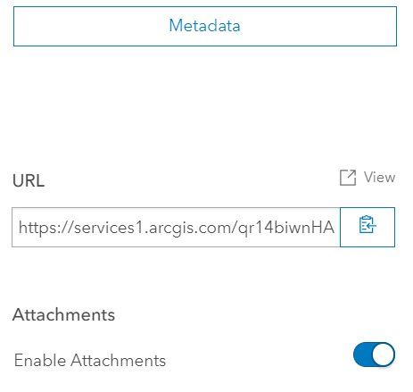
Field Maps for ArcGIS
In a similar way, Create another field named Notes that is a String.
For survey takers to be able to attach pictures showing the things in the parks, enable attachments:
Overview tab of the item page, scroll to the Layers list, and click on the layer name
Enable Attachments for the Places layer.

Slide 45
Make a map
Part 2

Slide 46
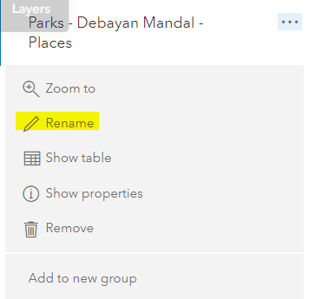
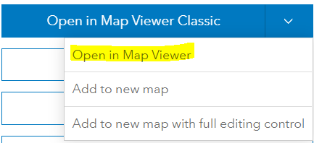
Field Maps for ArcGIS
Open in Map Viewer pick Add to new map to start making your map.
Save your map, giving it a title Parks and a tag Collect. (We learnt how)
In Layers pane, click More Options (…), choose Rename, and rename the layer of places to Parks.

Slide 47
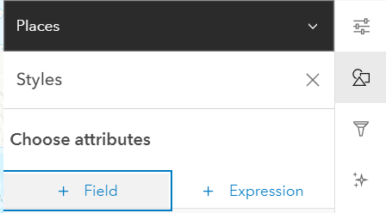
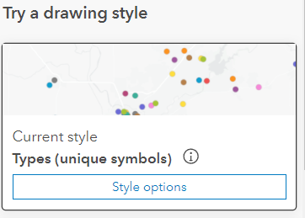
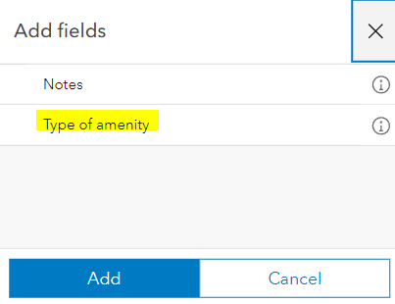
Field Maps for ArcGIS
Click Styles on the Settings pane
Choose to show the Type of amenity attribute. (Use +Field)
Make sure Current Styles is set to Types (unique symbols)

Slide 48
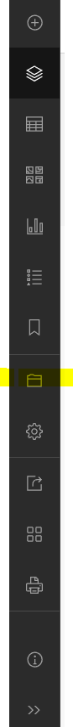
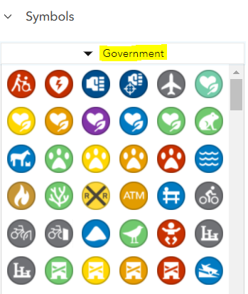
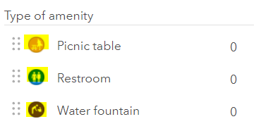
Collector for ArcGIS
Click Style Options
Change the icons according to the image below.
All of them are in Government Category. The option to change can be opened by clicking on existing icons for the categories. Confirm and save the changes. (Saving icon on the left)

Slide 49
Capture park assets in Field Maps
Part 3

Slide 50
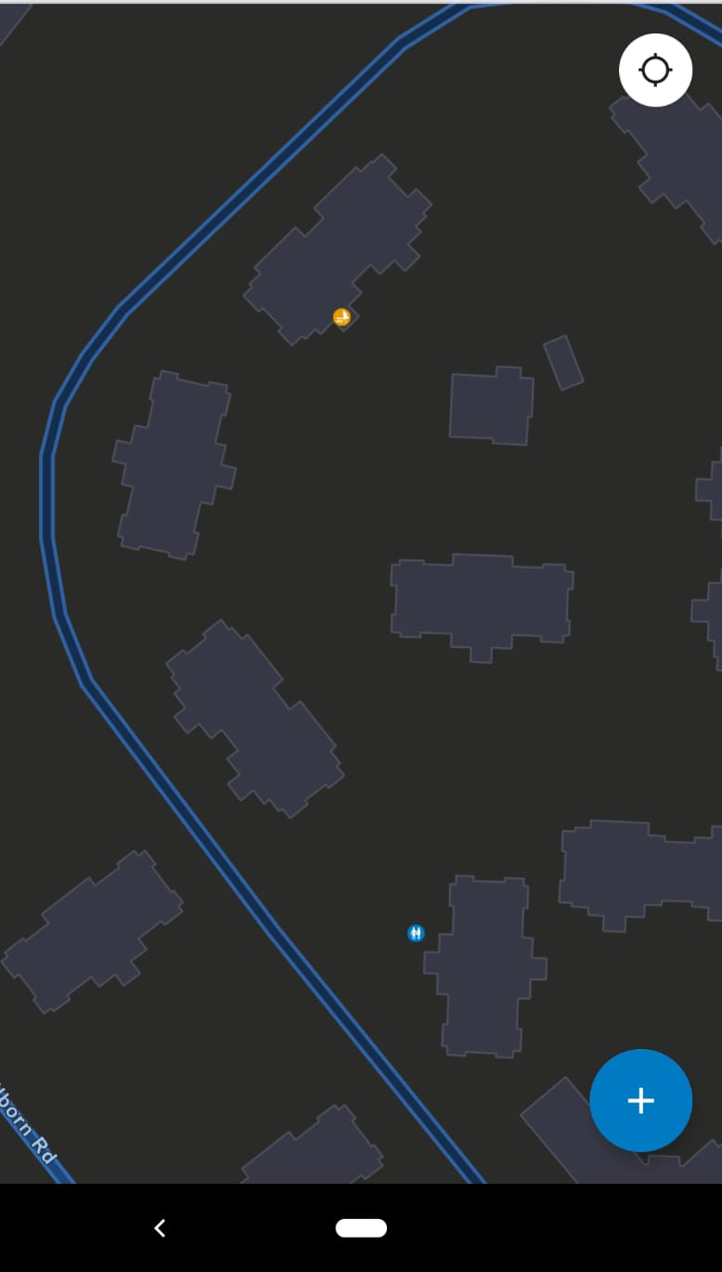
Field Maps for ArcGIS
Download ArcGIS Field Maps using Google Play in your mobile. Sign in to the organizational account.
Click on the “Parks” to access the collecting layer.
Play around with it and add some points. Submit the screenshot of the added points in your phone after updating them. Example on the right.
To make it public, change share settings and set feature layer to Public Data Collection from its options (not required for this exercise)

Slide 51
To Hand In
Canvas:
Web App link
Screenshot of web collector on your mobile
Upload these in a word document in your GitHub lab/week02 folder

Slide 52
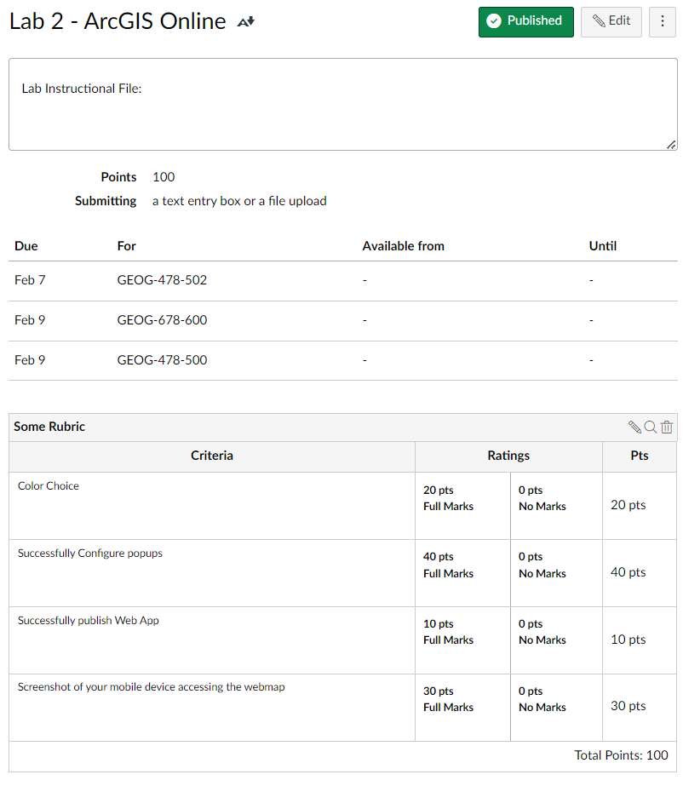
To Hand In

Slide 53
Thank You
Any Questions?

